Slide 1
Q1: build a flow to extract CSV file and convert it to json file then load it to mongoDB database
1- Use docker compose to run the following images:
mongodb: to load the data
Apache Nifi: to build the flow
Postgres: to load the data but I used mongodb
2- Save CSV file called data2 in the container and I renamed it to “data” which contains random data (faker library was used)
3- to run the container use docker-compose up command.
4- Use http://localhost:8080 to run Apche NiFi

Slide 2
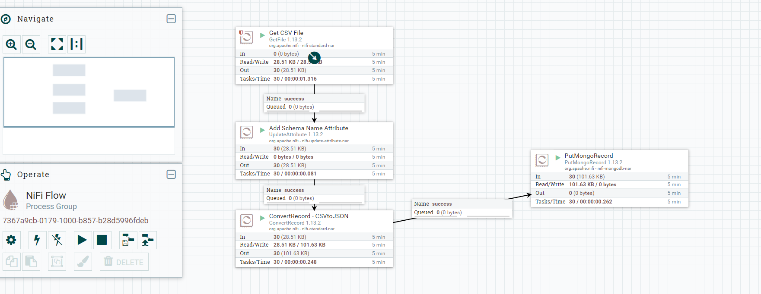
-NiFi Flow

Slide 3
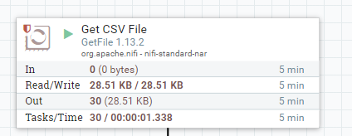
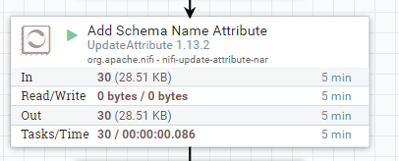
-Nifi Flow
4 processors have been used as following:
1- Get CSV File: extract CSV file called data.
2- Add Schema Name Attribute: build the schema to enable read the file

Slide 4
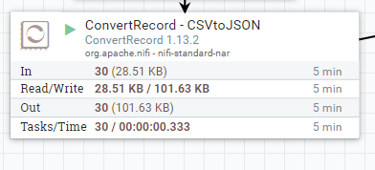
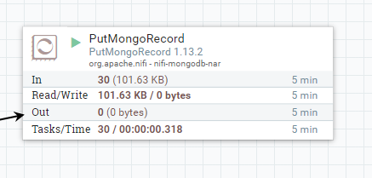
-Nifi Flow
4 processors have been used as following:
3- ConvertRecord - CSVtoJSON: convert CSV file to JSON
4- PutMongoRecord: build the schema to enable read the file

Slide 5
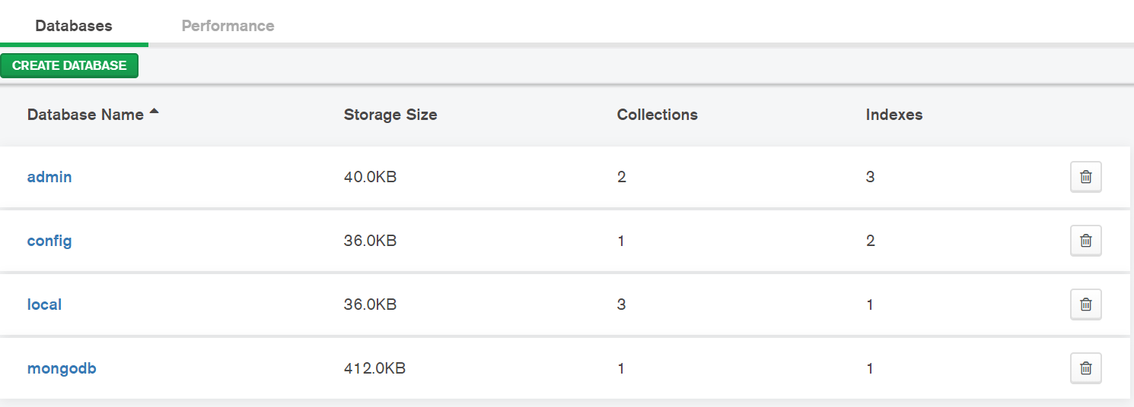
MongoDB compass:
I used it to visualize and understand the content of the data database
The name of the database is mongodb which used in the flow

